Slide 1
MTMM
Example

Slide 2
MTMM – Import the Data
For MTMM, usually you need all the data
Import the dataset provided
Remember, you can use the read.csv function or the import button in Rstudio
Don’t need the names since we import a real dataset

Slide 3
MTMM – Define Model
Traits:
Meaning: MLQ 1, 2, 5, 10 and PIL 4, 12, 17
Purpose: MLQ 3, 4, 6, 8, 9, and PIL 3, 8, 20
Methods:
Purpose in Life Test
Meaning in Life Questionnaire

Slide 4
MTMM – Define Model
First, build a methods only and traits only model, to make sure they run.
Measurement models - basic CFAs.

Slide 5
MTMM – Measurement Models
Run model, get output, draw pictures
Interpret:
Heywood cases:
Variances, Rsquares
Parameters
Residuals
Modification Indices
Fit Indices

Slide 6
MTMM – Model 1
For Model 1, include both the traits and methods.
Fix the covariances between traits and methods (not within them though!) to zero:
Method ~~ 0*trait

Slide 7
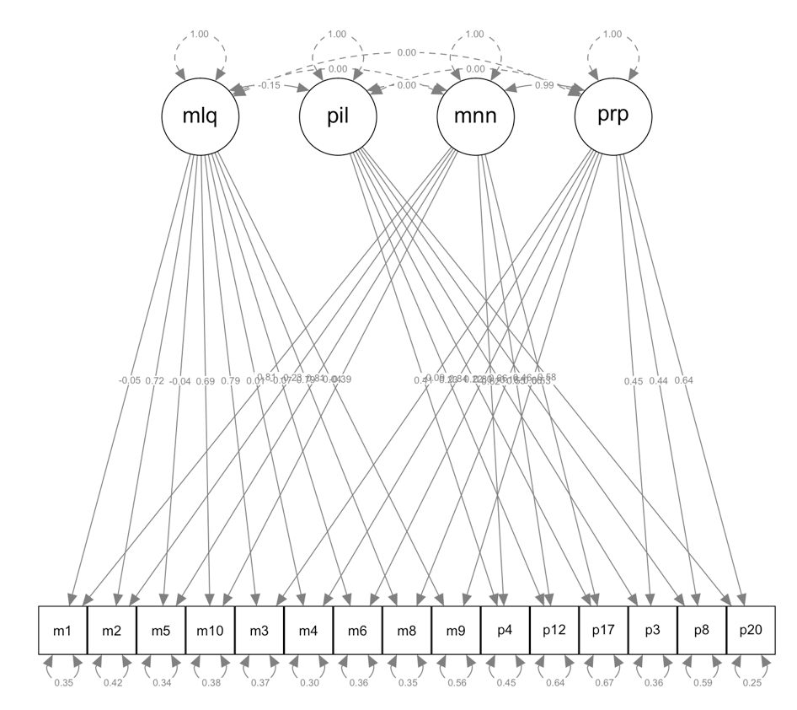

Slide 8
MTMM – Model 1
Remember this model should be the best.
Model | X² (df) | RMSEA | SRMR | CFI
Model 1 Correlated traits and methods | (73) 144.899 | 0.042 | 0.024 | 0.983
Model 2 No traits, correlated methods | (89) 1126.227 | 0.143 | 0.121 | 0.759
Model 3 Perfectly correlated traits, correlated methods | (74) 146.376 | 0.042 | 0.024 | 0.983
Model 4 Correlated traits, uncorrelated methods | (74) 147.707 | 0.042 | 0.025 | 0.983
anova(model1, model2)
anova(model1, model2, model3, model4) DON’T

Slide 9
MTMM – Model 2
For this model, we will delete the traits to see if they are important to include in the model
(so methods only, we’ve actually run this model at the start to make sure this MTMM would at least run).

Slide 10
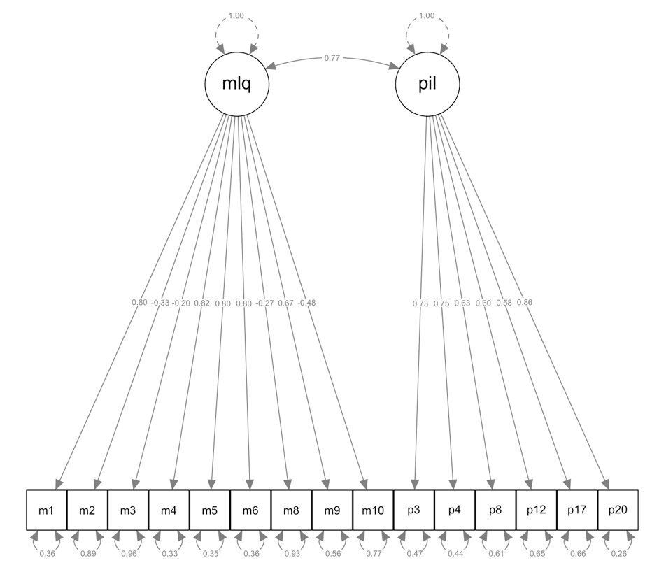

Slide 11
MTMM – Model 2
Model | X² (df) | RMSEA | SRMR | CFI
Model 1 Correlated traits and methods
Model 2 No traits, correlated methods
Model 3 Perfectly correlated traits, correlated methods
Model 4 Correlated traits, uncorrelated methods

Slide 12
MTMM – Model 3
For this model, we are perfectly correlating the traits to make sure that this model isn’t very good (otherwise why have multiple traits)

Slide 13
MTMM – Model 3
Model | X² (df) | RMSEA | SRMR | CFI
Model 1 Correlated traits and methods
Model 2 No traits, correlated methods
Model 3 Perfectly correlated traits, correlated methods
Model 4 Correlated traits, uncorrelated methods

Slide 14
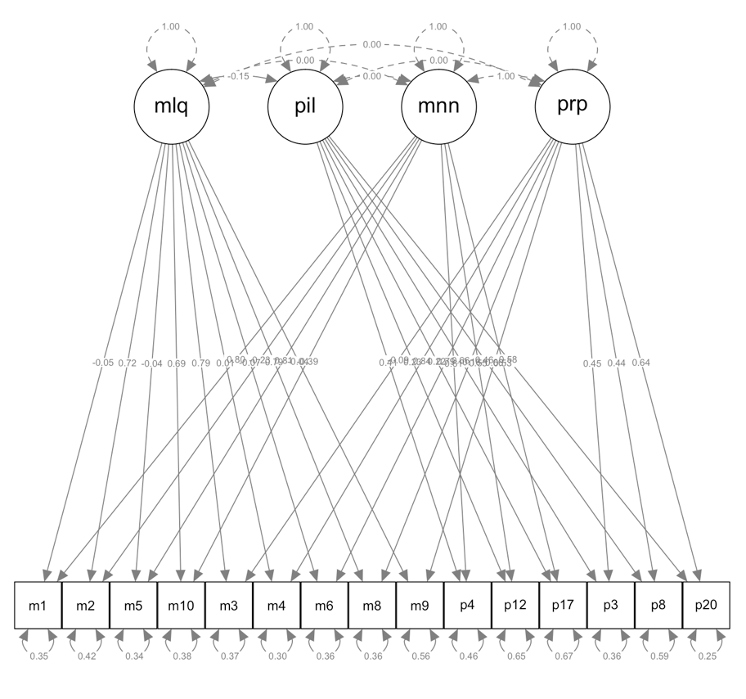

Slide 15
MTMM – Model 4
For this model, we are going to set the correlations between methods to zero – which should be just as good as model 1 so that the methods are not correlated.

Slide 16
MTMM – Model 4
Model | X² (df) | RMSEA | SRMR | CFI
Model 1 Correlated traits and methods
Model 2 No traits, correlated methods
Model 3 Perfectly correlated traits, correlated methods
Model 4 Correlated traits, uncorrelated methods

Slide 17
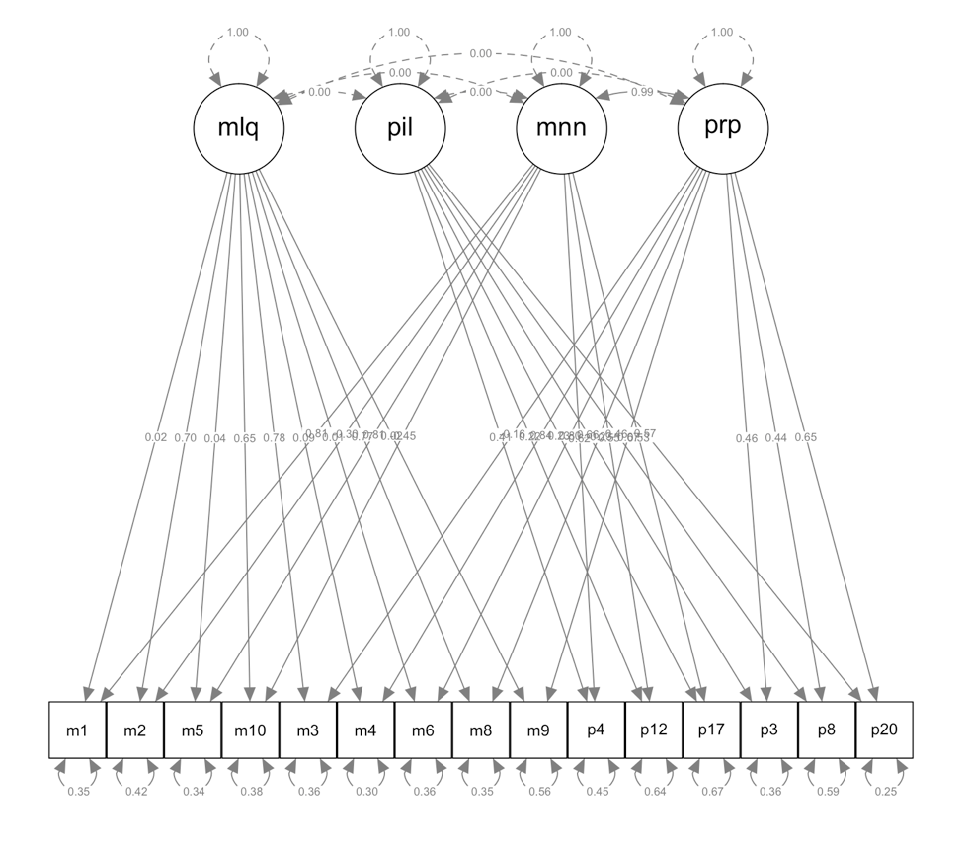

Slide 18
Interpret Parameters Model 1
 | Meaning | Purpose | MLQ | PIL
MLQ 1 | 1.09 | X | -.07 | X
MLQ 2 | -.41 | X | 1.276 | X
MLQ 5 | .99 | X | -.04 | X
MLQ 10 | -.75 | X | 1.30 | X
PIL 4 | .66 | X | X | .44
PIL 12 | .82 | X | X | .34
PIL 17 | .61 | X | X | .26
MLQ 3 | X | -.16 | 1.36 | X
MLQ 4 | X | 1.15 | .01 | X
MLQ 6 | X | 1.15 | -.10 | X
MLQ 8 | X | -.27 | 1.332 | X
MLQ 9 | X | .98 | -.07 | X
PIL 3 | X | .49 | X | .71
PIL 8 | X | .44 | X | .46
PIL 20 | X | .69 | X | .63

Slide 19
Interpret Parameters
Traits correlations
 | Purpose
Meaning | .99
Bad because it’s 1 effectively
Methods correlations
 | MLQ
PIL | -.15
Good because it’s close to zero

Slide 20
MTMM – Interpretation
So did our model meet the steps for MTMM?
What about the parameters?

